Slide 1
SARS Presentation Tax Compliance & Tax Practitioners

Slide 2
Points for Engagement
The SARS Story
SARS Strategic Focus
SARS Strategic Objectives
SARS Theory of compliance and the Compliance Model
Tax Compliance & Benefits: Tax Compliance Status
Repercussions of Non-Compliance - Third Party Appointment (AA88)
Repercussions of Non-Compliance: Administrative Penalties
Small Business Offerings
Tax Practitioner Offerings
Deregistration of Tax Practitioners
Ethical Conduct: Client confidentiality
Voluntary Disclosure Program
Go Digital

Slide 3

“THE STORY OF SARS IS A STORY ABOUT PEOPLE:
EVERYTHING WE DO IS ABOUT HAVING TRANSFORMATIONAL IMPACT ON THE WELL-BEING OF THE LIVES OF PEOPLE -ESPECIALLY THE MOST VULNERABLE AMONG US”
Commissioner Edward Kieswetter

Slide 4
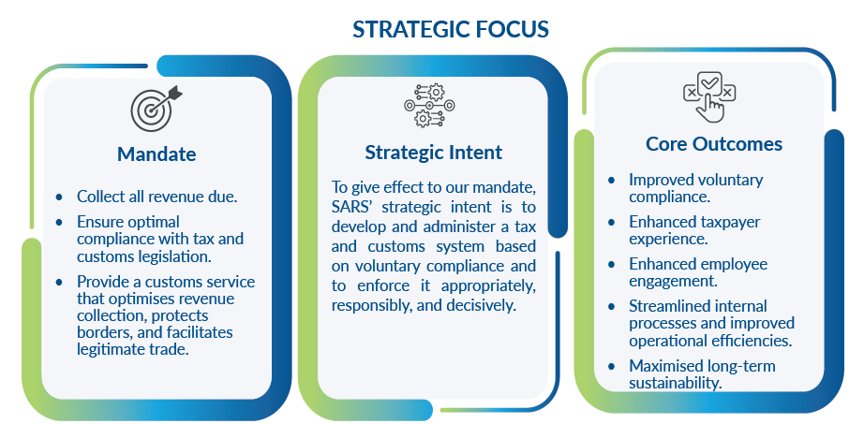
CLARITY OF PURPOSE: WHILST OUR LEGAL MANDATE IS TO:
…SARS exists to serve the HIGHER PURPOSE of
ENABLING GOVERNMENT TO BUILD A CAPABLE STATE
THAT FOSTERS SUSTAINABLE ECONOMIC GROWTH &
SOCIAL DEVELOPMENT THAT SERVES THE WELLBEING OF ALL SOUTH AFRICANS

Slide 5
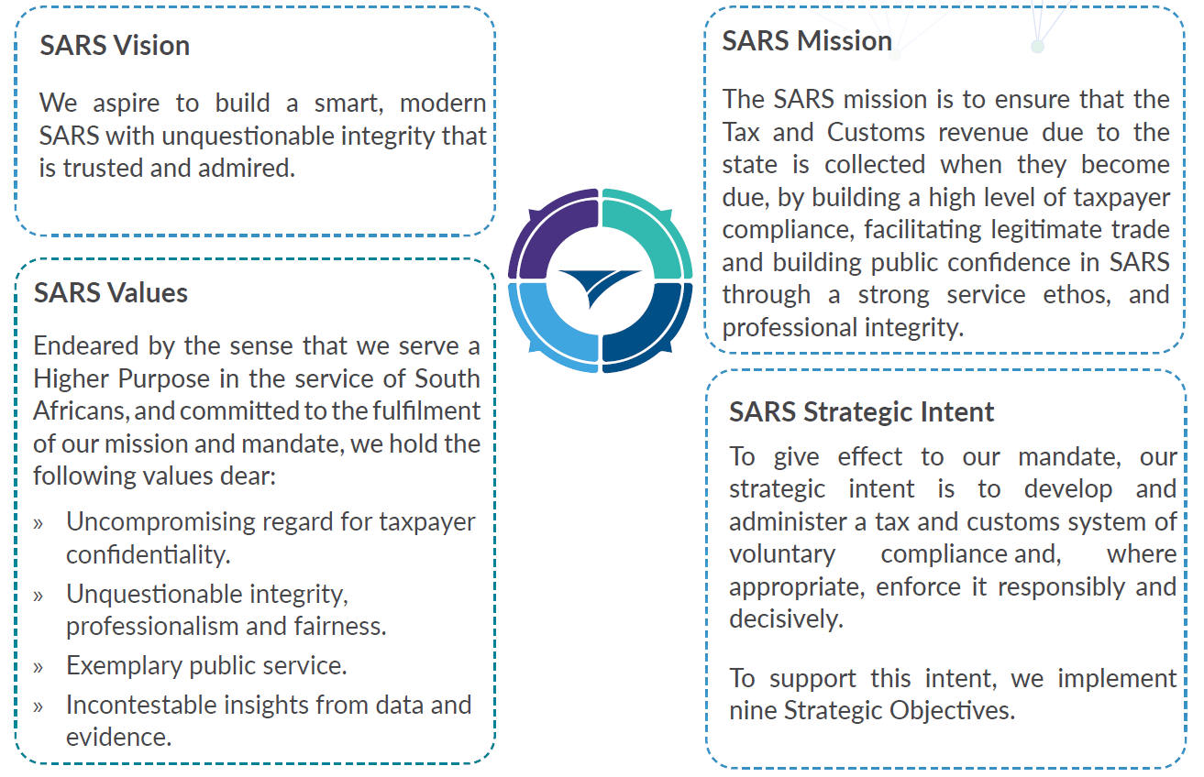
SARS Vision and Strategic Intent

Slide 6
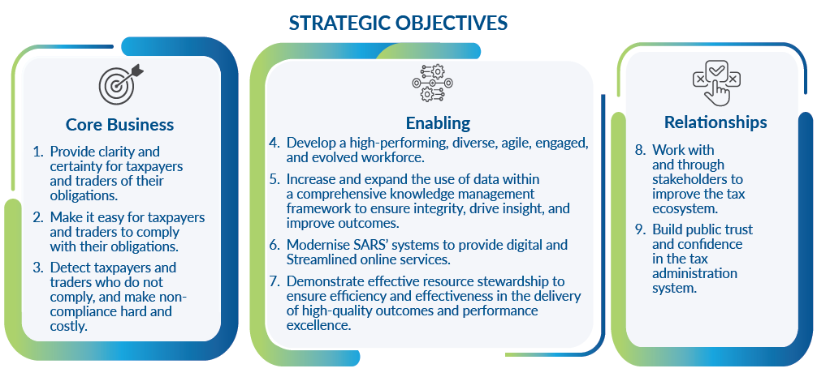
Strategic Objectives

Slide 7
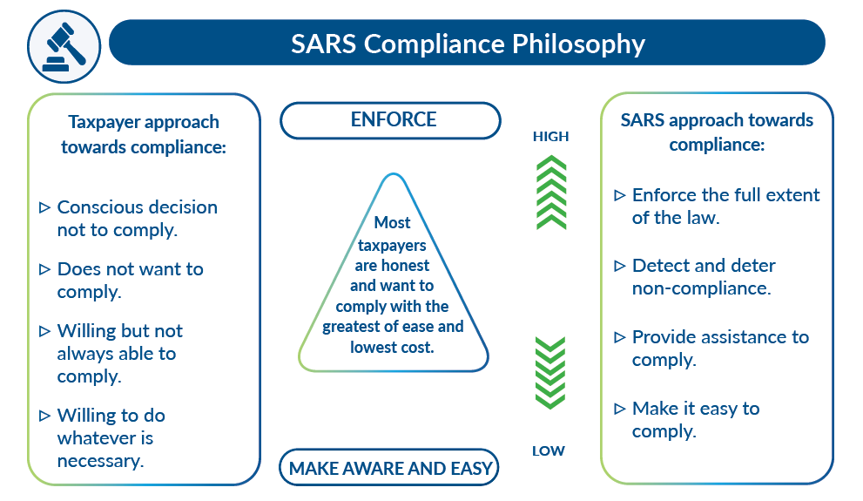
SARS Theory of Compliance
BELIEVING THAT MOST TAXPAYERS ARE HONEST AND SIMPLY WANT TO FULFIL THEIR OBLIGATION WITH THE LEAST AMOUNT OF EFFORT & COST

Slide 8

Tax Compliance & Benefits: Tax Compliance Status
Being tax compliant and ‘paying your fair share’ is not just good for you but also contributes to the growth of our country’s economy which in turn benefits all South Africans and Africa.
SARS introduced the Tax Compliance Status System in 2015 to replace the paper-based Tax Clearance system.
Once one applies for a Tax Compliance Status, one will receive a 4-digit security PIN which enables you to authorise any third party (an organisation or government) to view your status online via eFiling. This will present your overall tax compliance status at the date and time of viewing it. Pls NOTE : TCS is Real time check for Compliance.
To protect taxpayer confidentiality, no other information will be accessible to any third party.
The TCS system is available for the following applications:
Good standing
Approval International Transfer
The Tax Compliance Status system makes it easy for taxpayers to request their Tax Compliance Status (TCS) via eFiling or the SARS online query system (SOQS) to receive a PIN that can be used to authorise and enable third parties to verify your tax compliance status always.
NB: It is important to remember that a taxpayer’s compliance status is not static and changes according to ones continued compliance with tax requirements, it is Real Time Compliance.
Video

Slide 9
Repercussions of Non-Compliance - Third Party Appointment (AA88)
The Tax Administration Act empowers the Commissioner for South African Revenue Service (SARS) to appoint a third party to withhold and pay over to SARS any amounts due by a taxpayer. Such a third party may be an employer of the taxpayer, Banks or any other person, institution that has the management, custody or control of any income, monies or property under the name/ ownership of the taxpayer.
An appointed third party is required to do the following:
Review the list of impacted taxpayers (manage outcomes)
Deduct the stipulated amount from the salary or wages of the respective employees, as indicated
Pay the amounts over to SARS by the due date.
A Third-Party Appointment will be initiated against non-compliant taxpayers if:
Overdue balance on taxpayer’s account, all tax types (administrative penalty and/or assessed tax debt) occurs
There was previous communication and or final demand letter was issued to the taxpayer, and the taxpayer has not complied with such due payment.

Slide 10
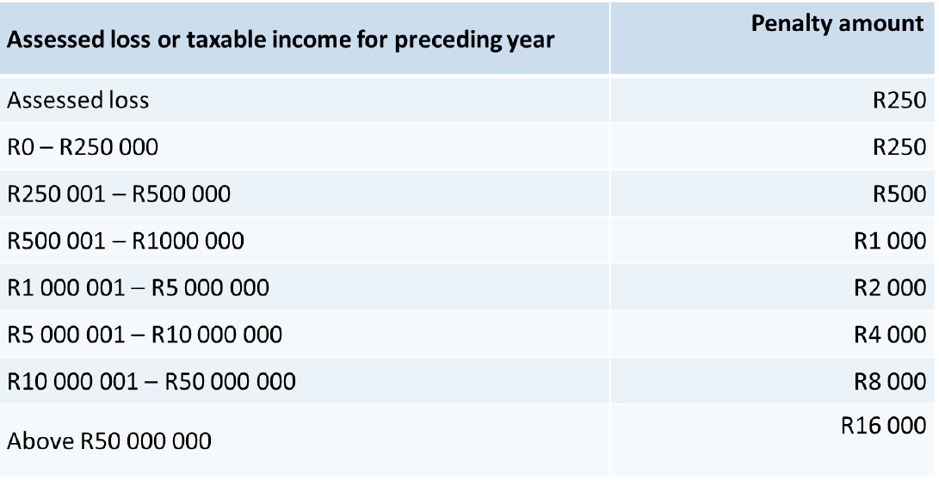
Repercussions of Non-Compliance: Administrative Penalties
As permitted by section 75B of the Income Tax Act, No. 58 of 1962, effective 1 January 2009, SARS has begun imposing a range of stringent penalties in respect of non-compliance by taxpayers, which includes the following:
Failure to register as a taxpayer
Failure to inform SARS of a change of address and other personal particulars
Failure to submit Income Tax returns (ITR12) and other documents.
The abovementioned non-compliances are subject to a recurring penalty (this penalty will be charged each month until the non-compliance has been remedied). The amount of the penalty is determined according to the taxpayer’s taxable income or assessed loss.

Slide 11

Small Business Offerings
Small, Medium, and Micro Enterprises (SMMEs) are vital to South Africa’s economy. They account for approximately 34% of South Africa’s GDP and employ 60% of the workforce.
Complying with your tax obligations as a small business has been made a lot easier over the past few years. www.sars.gov.za/businesses-and-employers/small-businesses-taxpayers/
SMME Connect provide essential updates www.sars.gov.za/businesses-and-employers/small-businesses-taxpayers/smme-connect-13-february-2026-edition/

Slide 12

Tax Practitioner Offerings
A comprehensive Tax Practitioner page providing all necessary information and resources can be accessed: Tax Practitioners | South African Revenue Service
Service offerings per channel: www.sars.gov.za/tax-practitioners/service-offerings-per-channel-for-tax-practitioners/
Practitioner connect provide essential updates to assist you navigate the months ahead: Tax Practitioner Connect Issue 68 (November 2025) | South African Revenue Service

Slide 13
Deregistration of Tax Practitioners
Implementing section 240(3)(d) of the TAA, SARS issued letters of intention to deregister tax practitioners, due to continuous non-compliance.
Tax Practitioners have 21 business days to take remedial action, failing which, any delay will result in their tax practitioner status being deregistered and their RCBs being notified.
Tax Practitioner External Guide

Slide 14

Ethical Conduct: Client confidentiality
Tax Practitioners must maintain the confidentiality of their clients and should not disclose client information to a third party without a client's permission, unless there is a legal obligation to do so. Information disclosed by the client should not be used by anyone including Tax Practitioner for personal gain.
Tax Practitioners need to maintain their Professional conduct under all circumstances.
Use escalation processes available to them should there be a situation that requires such escalation.

Slide 15

Conclusion - # Your Tax Matters: Thank You South Africa
In more than 30 years since our freedom, honest taxpayers and traders have contributed R23.3 trillion to our young democracy. We should never take SARS and Taxes for granted. The administrative efficiency and effectiveness of the tax and customs administration, despite limited economic growth, have meant that as a nation we are not what economists classify as a “heavily indebted poor country”. we can exercise our sovereignty substantively and Win.
SARS always acts without fear, favour, or prejudice in discharging our Mandate. Our conviction is that most taxpayers and traders are honest, and if we help them to understand their obligation, and work hard to make them fulfil such obligation easy, they will voluntarily comply. In their name, we will also continue to enforce and prosecute those who break the law or do not comply, intentionally.
Once again : THANK YOU for paying your taxes during the past financial year. Your contribution has enabled us to announce a revenue result of R1,855,090 bn, over by 8.9 Billion while improving compliance from 62.85% to 66.29%., Taxpayer service has increased by 5.8% from last year to 87.13%. This is indeed a story of HOPE.
We are equally pleased that SARS employees through an employee engagement survey demonstrates a steady and remarkable improvement year on year. In the year 2024/2025, it stands at 71% from 69% in 2023/2024, moving from 61% in 2019/2020. This positive development communicates a clear message that every year our employees are committed to serve our country with steadfast determination and pride.

Slide 16
VDP PROCESS

Slide 17
Role of VDP on SARS's Strategic Intent Of Promoting Voluntary Compliance.
Providing Clarity and Certainty
Provides clarity and certainty for taxpayers and traders
Taxpayers can interact anonymously with VDP unit
Non-binding private opinion issued by VDP unit
Binding agreements on tax defaults.
A secure and confidential setting for regularising tax matters.
Notes:
VDP operates in a ringfenced environment. Only VDP members have access to VDP application and information
Abinding upon SARS. Default relief amount payable an
In the event taxpayer sare unsure of their eligibility to apply for VDP, taxpayer may make request for a non binding private opinion by applying via efiling. Evalauted and an opinion will be provided. This will enable the taxpayer to make an informed decision.

Slide 18

Role of VDP on SARS's Strategic Intent Of Promoting Voluntary Compliance.
Making it easy for taxpayers and traders to comply with their obligations
Finalisation within 90 days upon receipt of required information.
Acceptance of reasonable estimates when documents are unavailable.
Collaborative approach to assist taxpayers.
Simplified process to remedy past non-compliance for non-compliant taxpayers and traders.

Slide 19
Stakeholder Engagement and enhancing public trust and confidence
Fostering positive relationships with professional bodies and tax practitioners
Enhancing stakeholder awareness of the VDP is crucial.

Slide 20
Benefits of the VDP
Section 229 of the Tax Administration Act; SARS must:
Not pursue criminal prosecution for a tax offence arising from a ‘default’,
Grant relief in respect of any understatement penalty referred to in column 5 or 6 of the understatement penalty percentage table in section 223.
Grant 100 per cent relief in respect of an administrative non-compliance penalty imposed under Chapter 15 or a penalty imposed under a tax act, excluding a penalty imposed for the late submission of a return
Information, including the VDP01 Form and supporting documents submitted via the VDP process are not shared with any other division within SARS.

Slide 21
Who may apply for VDP?
Individuals
Companies and / or
Representative of such individual or company
A person who is not given notice of commencement of audit or criminal investigation
Exceptions:
A senior SARS official may direct that a person under audit / investigation may still apply, under certain circumstances.
NB:
Where the taxpayer does not have proper records; a reasonable estimate will be accepted.

Slide 22
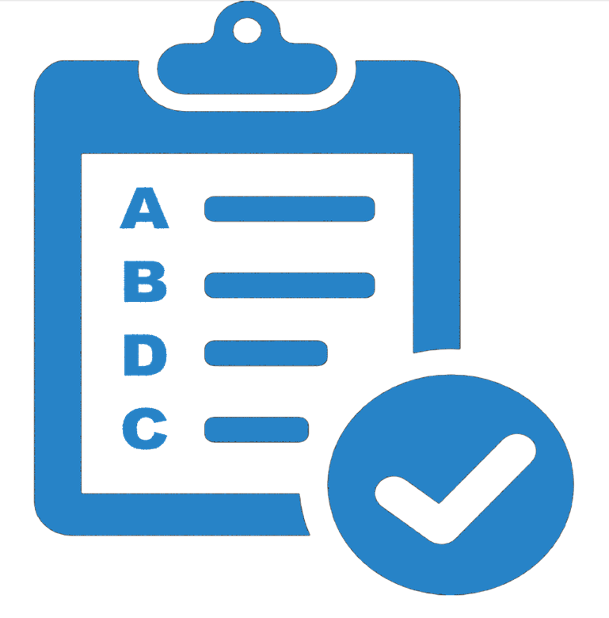
Requirements for Valid VDP
Compliance with Section 227 is required refer www.sars.gov.za for detailed explanation of Sec 227.
The declaration of a default must be voluntary
The default being disclosed must not be similar to another default previously disclosed in the last 5 years
Full and complete disclosure of all material respects
The default must involve a behaviour listed under the understatement penalty percentage table in section 223 of the TA Act
The declaration must not result in a refund due to the taxpayer
The application must be made in the prescribed form and manner

Slide 23
Service Charter Commitments
SARS strives to ensure that it meets its Service Charter measures in relation to VDP by ensuring:
Allocation of 9 out of 10 applications within 30 business days of receipt thereof.
Finalise 9 out of 10 applications within 90 business days where all requested documents have been received unless alternative arrangements are communicated.

Slide 24

VDP Queries
VDP related queries may be directed to VDP mailbox: vdp@sars.gov.za or by VDP Division toll free line 0800 864 613
Refer to the External Guide- Voluntary Disclosure Programme or visit VDP portal for more information and FAQs.

Slide 25
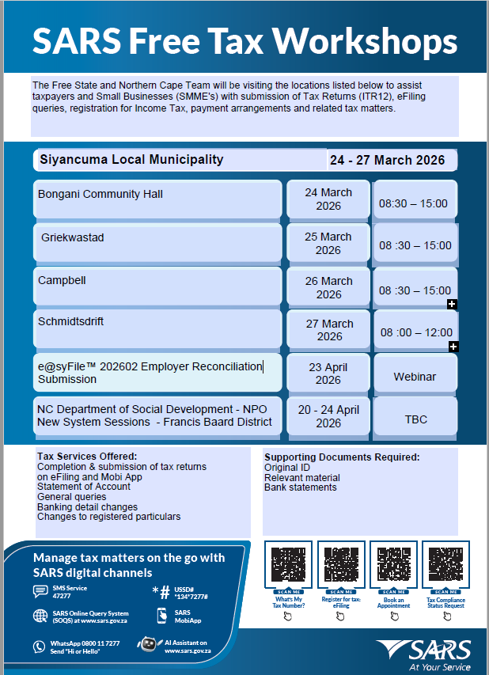
Tax Workshops and Tax Clinics

Slide 26
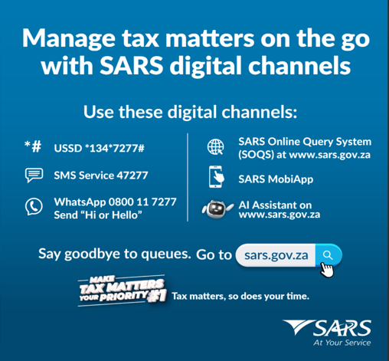
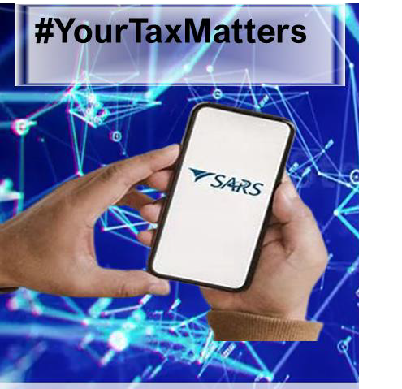
Go Digital

